Slide 1
BIA 650
Process Innovation and Management
7 – Non-Linear programming
Definition
Basic Calculus Optimization
  Economic Order Quantity
  Pricing
Method of Steepest Ascent
  Example Problem
Lagrange Multipliers
© E. A. Stohr, 2017
Notes:
Up to this point, we have been concerned with choosing & designing business processes.
In this lecture, we look at:
Simulation: How to check alternative process designs
WFMS: How to automate processes
Since not all processes can be expressed as fixed workflows, we also look at:
Groupware: How to support coordination in unstructured situations
Finally, we look at 2 real case studies involving the implementation of a WFMS

Slide 2
Non-Linear Programming
Wikipedia:
Nonlinear programming (NLP) is the process of solving a system of equalities and inequalities, collectively termed constraints, over a set of unknown real variables, along with an objective function to be maximized or minimized, where some of the constraints or the objective function are nonlinear.

Slide 3
NonLinear Programming
Maximize c(x₁.x₂……x_{n})
Subject to:
a_{i} (x₁.x₂……x_{n}) < 0 for i = 1,2,……,m
Many applications:
  Process control
  Pricing models
  Portfolio optimization
  Petroleum blending
  Probabilistic elements

Slide 4
Nonlinear function of a single variable
x2
x2
Concave function
Convex function
Gradient is always decreasing
Gradient is always increasing
x1
x1
p.c(x1) +(1-p).c(x2) < c(p.x1+(1-p).x2)
p.c(x1) +(1-p).c(x2) > c(p.x1+(1-p).x2)
0 < p < 1
0 < p < 1
Global maximum
x2
Local Minimum
Global Minimum
x1

Slide 5
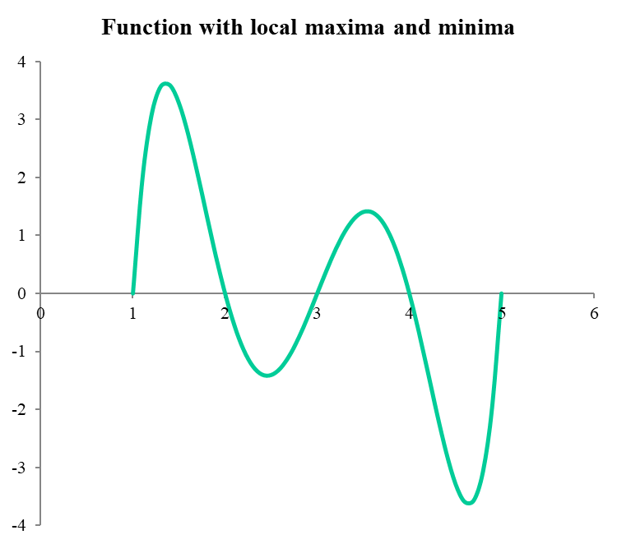
Local Maxima and Minima
The function is: y=(x-1)(x-2)(x-3)(x-4)(x-5)
x | 3.5
x-1 | 2.5 |  |  | =B5-1
x-2 | 1.5
x-3 | 0.5
x-4 | -0.5
x-5 | -1.5
Product | 1.406
x | y
 | 1.406
1 | 0
1.1 | 1.934
1.2 | 3.064
1.3 | 3.566
1.4 | 3.594
1.5 | 3.281
1.6 | 2.742
1.7 | 2.072
If you start GRG, for example, at x=3.5, you get a local maximum
Use One-way Data Table to graph the function

Slide 6
Conditions for Profit Maximization
Total Revenue, R=R(Q)
Total Cost, C=C(Q)
Max Profit, P= P(Q)= R(Q) – C(Q)
dP/dq = P’(Q) = R’(Q) – C’(Q) = 0 for an optimum
thus, a necessary condition for profit maximization is
R’(Q) “Marginal Revenue” (MR) = C’(Q) “Marginal Cost” (MC)
The second order condition for a maximum must also be satisfied, i.e.
P’’(q) = R’’(q) – C’’(q) < 0
i.e., the rate of change of MR is less than the rate of change of MC at optimum
R, C
R(Q)
C(Q)
Q*
Q

Slide 7
Math Background
Elementary Calculus Checkpoint
Economic Order Quantity (inventory theory)
a = inventory draw down rate (or demand) units per period
K= ordering cost (or production set-up cost)
c = purchase (or production) cost per item
h = inventory holding cost per item
Q = order size
Determine the optimal value of Q (and simultaneously the time between orders) to minimize the inventory cost per unit time
Hint: What is the average amount of inventory on hand?

Slide 8
Economic Order Quantity
Machey's EOQ model | W&A Ch 12
Inputs |  |  | Range names used:
Fixed ordering cost | $125 | K | Annual_demand | =Model!$B$8
Annual interest rate | 8% |  | Annual_interest_rate | =Model!$B$5
Unit purchasing cost | $100 | c | Annual_profit | =Model!$B$21
Selling price per unit | $130 |  | Fixed_ordering_cost | =Model!$B$4
Annual demand | 1200 | a | Order_quantity | =Model!$B$12
Lead time in years | 1/52 |  | Orders_per_year | =Model!$B$13
 |  |  | Selling_price_per_unit | =Model!$B$7
Ordering model |  |  | Unit_purchasing_cost | =Model!$B$6
Order quantity | 193.65 | Q
Orders per year | 6.20
Time between orders (days) | 58.90
 |  | h = Holding Cost/unit/time = Interest rate * Unit cost
Monetary values
Annual fixed ordering cost | $775
Annual holding cost | $775
Annual purchasing cost | $120,000
Annual revenue | $156,000 | Fixed - not really part of the problem
Annual profit | $34,451
Alternative EOQ formula | 193.65
SQRT(2*Fixed_ordering_cost*Annual_demand/(Annual_interest_rate*Unit-purchase_cost))

Slide 9
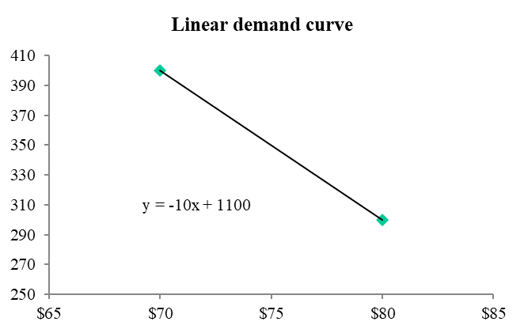
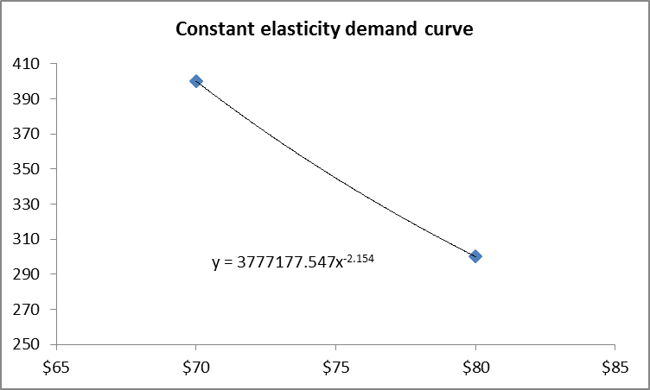
Demand Curves (Example 7.1 text, page 352)
Two points on the demand curve (as estimated by Madison)
 | Price | Demand
 | $70 | 400
 | $80 | 300
Problem
Find the price that maximizes revenue.
Unit cost, C = $50
Given demand at two different price points
Assume 2 different demand functions as follows:
Draw a scatterplot (in this case, there are only 2 points)
Use Trendlines with function option to display formulae

Slide 10
Pricing Elasticity (Example 7.1 text, page 352)
Price Elasticity of Demand
Relates price to demand
Elasticity = - dQ/Q/dp/P
= (Proportional decrease in demand/proportional increase in price)
In-class Exercise
Constant elasticity demand function has the form:
Demand, Q = aP^{b}
P = price (decision variable)
1. Show Q = aP^{b} exhibits constant elasticity
2. Find the optimal price (ignore constraint that P should be greater than c the cost per unit)

Slide 11
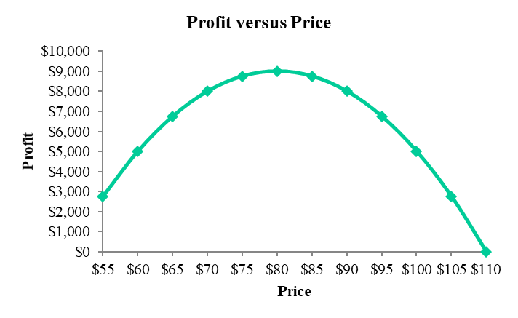
Linear Demand Curve Ex 7.1
Madison pricing model with linear demand function |  |  |  |  |  |  | Range names used:
 |  |  |  |  |  |  | Price1 | =Linear!$B$10
Unit cost | $50 |  |  |  |  |  | Profit1 | =Linear!$B$12
 |  |  |  |  |  |  | Unit_cost1 | =Linear!$B$3
Parameters of linear demand function (from first sheet)
 | Intercept |  | Slope
 | 1100 |  | -10
Pricing model
Price | $80
Demand | 300.00
Profit | $9,000
Verification with a data table and corresponding chart
Price | Profit
 | $9,000
$55 | $2,750
$60 | $5,000
$65 | $6,750
$70 | $8,000
$75 | $8,750
$80 | $9,000
$85 | $8,750
$90 | $8,000
$95 | $6,750
$100 | $5,000
$105 | $2,750
$110 | -$0
Note: Elasticity (absolute value) increases with price)
=1100 – 10*P

Slide 12
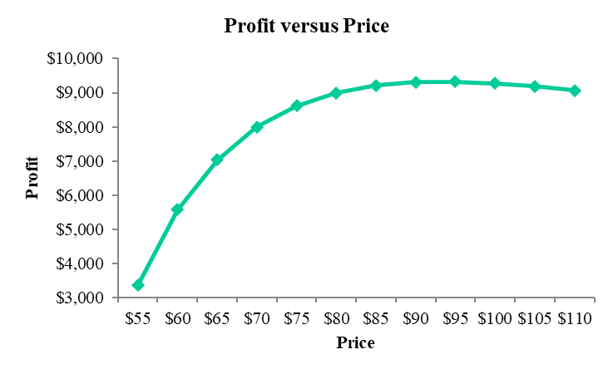
Constant Elasticity of Demand
Madison pricing model with constant elasticity demand function
Unit cost | $50
Parameters of constant elasticity demand function (from first sheet)
 | Constant | Elasticity
 | 3777178 | -2.154 |  |  | Range names used:
 |  |  |  |  | Price2 | ='Constant Elasticity'!$B$10
Pricing model |  |  |  |  | Profit2 | ='Constant Elasticity'!$B$12
Price | $93.31 |  |  |  | Unit_cost2 | ='Constant Elasticity'!$B$3
Demand | $215.33
Profit | $9,326
Verification with a data table and corresponding chart
Price | Profit
 | $9,326
$55 | $3,363
$60 | $5,576
$65 | $7,039
$70 | $8,000
$75 | $8,619
$80 | $9,000
$85 | $9,214
$90 | $9,311
$95 | $9,323
$100 | $9,275
$105 | $9,184
$110 | $9,064
=3777178*Price2^-2.154

Slide 13
Peak Load Pricing (W&A) Ex 7.4
In peak-load situations, it might be optimal for a producer to charge a larger price for peak-load service than for off-peak service.
Florida Power and Light (FPL)
The daily demand (D_{p} and D_{o}) for power during each period (in kwh) is:
D_{p} = 60 – 0.5P_{p} + 0.1P_{o}
D_{o} = 40 – P_{o} + 0.1P_{p}
  Note: An increase in the peak-load price decreases the demand for power during the peak period but increases the demand for power during the off-peak period (and, vice versa).
Thus, peak-load power and off-peak power are substitutes for one another.
It costs FPL $10 per day to maintain 1 kwh of capacity.
Objective:
The company wants to determine a pricing strategy and capacity level that maximizes its daily profit.

Slide 14
Peak Load Pricing (W&A) Ex 7.4
Florida Power & Light peak-load pricing model
Coefficients of demand functions
 | Constant | Peak price | Off-peak price
Peak-load demand | 60 | -0.5 | 0.1
Off-peak demand | 40 | 0.1 | -1
Cost of capacity/kwh | $10
Decisions
 | Peak-load | Off-peak
Prices | $70.31 | $26.53
Capacity | 27.50
Constraints on demand | Peak-load | Off-peak
Demand | 27.50 | 20.50
 | <= | <=
Capacity | 27.50 | 27.50 | (RHS’s are Variable)
Monetary summary
Revenue | $2,477.30
Cost of capacity | $275.00
Profit | $2,202.30
=B6+SUMPRODUCT(Prices,C6:D6)
=SUMPRODUCT(Demands, Prices)

Slide 15
Steepest Ascent
1. Select an arbitrary initial trial point, x₀
2. Terminate if әc/ әx_{j} = 0 for j =1,2,..,n at x^{k}
3. Determine values y^{k}_{j ,} for j = 1,2, …, n
4. Calculate a new trial point,
x^{k+1}_{j} = x^{k}_{j} + y^{k}_{j} for j = 1,2, …, n
5. Return to step 2 where x^{k+1} replaces x^{k}
Usually do not satisfy condition at step 2 so need a rule when nearly optimal or all values of әc/ әx_{j} are sufficiently small.

Slide 16
Steepest Ascent (ctd.)
Determining the optimal step size. At step k:
Pick a direction, d^{k}_{j}, for j= 1,2,…, n
A good choice for the direction vector, d^{k} ,is the gradient vector
d^{k} = (әc/ әx₁, әc/ әx₂, ……, әc/ әx_{n})
Then compute a scalar, t^{k} , that maximizes
c(x^{k}₁ + t^{k}. d^{k}₁ , x^{k}₂ + t^{k}. d^{k}₂ , …., x^{k}_{n} + t^{k}. d^{k}_{n} ) (1)
That is find t^{k} to maximize expression (1)

Slide 17
Graphic - Method of Steepest Ascent
The gradient vector is at right angles to the contour --- this gives d¹ the direction of steepest ascent at (0,0)
x₂
The optimal value of t¹ finds this point.
(x₁¹,x₂¹)
0.826, 2.204
Direction of steepest ascent at (x₁¹,x₂¹)
x₁

Slide 18
Example Steepest Ascent (ctd.)
Max C(x) = -(x₁-3)² – 4(x₂-2)²
At (0,0), c(0,0) = -25
Starting at x⁰ = (0,0) , find d⁰₁ = 6 and d⁰₂ = 16 (see next slide)
Note: we are starting at (0, 0) --- >
Then the next point will be defined by (0 + 6t, 0 + 16t)
Hence, we must find the optimal value, t⁰, of t by maximizing the single variable optimization problem in t:
[-((0+6t) – 3)² – 4((0+16t)-2)² ] (2)
What are the coordinates of the new starting point, ( x¹₁,x¹₂)?

Slide 19
Steepest Ascent Example (ctd.)
әc/ әx₁ : -(x₁-3)²-4(x₂-2)²
= 6-2x₁
=6-2(0)
=6
әc/ әx₂ : -(x₁-3)²-4(x₂-2)²
=-8(x-2)
=-8(-2)
=16
So d = (6,16)
and we need to find t to maximize (see (2):
Z = [-(6t – 3)² – 4(16t-2)² ]

Slide 20
Steepest Ascent (ctd.)
d/dt[-(6t – 3)² – 4(16t-2)² ]
= d/dt(-[36t²-36t+9]-4[256t²-64t+4])
= d/dt(-36t²+36t-9-1024t²+256t-16)
= d/dt(-1060t²+292t-25)
=-2120t+292 = 0 ===> t = 292/2120
Then the next point is:
(X₁¹,X₂¹) = (0+6*292/2120), 0+16*292/2120)
= (0.826, 2.204)
The value of -(x₁-3)² – 4(x₂-2)² at (0.826, 2.204) is -4.891.
So we have improved the value of the solution from
-25 at (0.0) to -4.891 at (0.826, 2.204)
The next step is to find the direction of steepest ascent at (X₁¹,X₂¹) and repeat the process until the improvement is small.

Slide 21
NLP with Constraints
The solution of the more general NLP problem with constraints is more difficult.
Maximize c(x₁.x₂……x_{n})
Subject to:
a_{i} (x₁.x₂……x_{n}) < 0 for i = 1,2,……,m
A simple exposition of the necessary and sufficient conditions (the so-called Kuhn-Tucker Conditions) for an optimal solution to this problem is given in:
http://mjo.osborne.economics.utoronto.ca/index.php/tutorial/index/1/moi/c
Excel’s Solver uses an Algorithm called the “Generalized Reduced Gradient” (GRG).

Slide 22
Simple Constrained Optimization
Method of Lagrange Multipliers
Maximize z = xy
Subject to:
2x + y – 6 = 0
Augmented Objective Function
Z = xy + Λ (2x + y – 6) where Λ is a “Lagrange multiplier”
At an optimum:
әZ/ әx = Z_{x} = y + 2 Λ = 0 hence y = 2x
әZ/ әy = Z_{y} = x + Λ = 0 hence Λ = - x
әZ/ ә Λ = Z_{Λ} = 2x + y – 6 = 0 hence x = 6/4 = 3/2
Solution: x = 3/2, y = 3, Λ = - 3/2

Slide 23
Lagrange Multipliers (ctd.)
Graphical Interpretation
z
(Utility)
y
Unconstrained Optimum
Constrained Optimum
Feasible region
Budget constraint
x
The Lagrange Multiplier method can be extended to more than one constraint. Simply add each constraint with its own multiplier into the objective function and differentiate to find the first-order (necessary) conditions for an optimal solution.

Slide 24
Separable Convex Programming
The general NLP problem is
Maximize c(x₁.x₂……x_{n})
Subject to: g_{i} (x₁.x₂……x_{n}) < 0 for i = 1,2,……,m
Suppose the objective function is separable:
c(x) = c₁(x₁) + c₂(x₂) + … c_{n}(x_{n})
where all the c_{j}(x_{j}) are concave functions and all the constraints are linear (and therefore convex).
Then we can simplify by approximating each c_{j}(x_{j}) by a piece-wise linear function to give an LP as shown below.
(Note that if all the constraints, g_{i}(x), are separable and convex, they could also be approximated by piecewise linear functions.)

Slide 25
Separable Convex Programming
c_{j}(x_{j})
x_{j1}
x_{j2}
x_{j3}
x_{j4}
x_{j}
Introduce variables, x_{j1,} x_{j2} etc. with associated line segments each with a different slope.
Express the linear constraints in terms of these new variables and impose a new set of restrictions. This is conceptually easy but messy.

Slide 26
Separable Convex Programming
Max 3X1 + 5X2 (3 and 5 are contribution margins assuming no overtime)
st: 3X1 + 2X2 < 18
X1 < 4,
X2 < 6
Suppose 3 < X1 < 4; and 3 < X2 < 6 involve overtime, so that the contribution margins (slopes) are as follows:
Here, the concave functions are already piece-wise linear. The problem becomes:
Max 3X11 + 2X12 + 5X21 + X22
st: 3(X11 + X12) + 2(X21 + X22) < 18
X11 < 3
X12 < 1
X21 < 3
X22 < 3
(Plus non-negativity constraints)
Slope = 1
X22
$
Slope = 5
X21
Slope = 2
X12
Note: If the optimal solution says that X11 = 3 and x12 = 0.5
then we should produce 3.5 units of X1
Slope = 3
X11
Xj
3
4
6

Slide 27
Example NLP: Facility Location
Warehouse location that minimizes annual distance travelled
C3
10
C1
WH
5
C2
C4
5
10
This is a non-linear problem because we need to minimize the weighted sum of Euclidian distances. It is unconstrained and the objective function is convex.

Slide 28
Example NLP: Facility Location
Lafferty facility location model
Customer data
 | X-coordinate | Y-coordinate |  | Annual shipments
Customer 1 | 5 | 10 |  | 200
Customer 2 | 10 | 5 |  | 150
Customer 3 | 0 | 12 |  | 200
Customer 4 | 12 | 0 |  | 300
Warehouse location | X-coordinate | Y-coordinate |  | Range names used:
 | 9.314 | 5.029 |  | Location
 |  |  |  | Total_annual_distance
Customer distances from warehouse
Customer 1 | 6.582
Customer 2 | 0.686
Customer 3 | 11.634
Customer 4 | 5.701
Total annual distance | 5456.540
=SQRT(SUMXMY2(B5:C5,Location)
=SUMPRODUCT(E5:E8,B14:B17)

Slide 29
In-class Exercise - 1
Demand, Q = aP^{b} (constant elasticity demand function)
a = constant
b = coefficient of elasticity
P = price (decision variable, c = cost per unit
1. Show Q = aP^{b} exhibits constant elasticity
Elasticity = (Proportional decrease in demand/proportional increase in price)
= - dQ/dP / Q//P = - dQ/dP / Q/p
= - abP^{b-1} / aP^{b} /P = b
Find the optimal profit-maximizing price if c = cost per unit (ignore constraint that P should be greater than c)
Rev = P.Q – cQ
=P.aP^{b} – c. aP^{b}
dRev/dp = a(b+1).P^{b} –c.abP^{b-1} = 0
Hence: a(b+1).P = c.ab
P* = cb / (b+1)

Slide 30
In-class Exercise - 1
Demand, Q = aP^{b} (constant elasticity demand function)
a = constant
b = coefficient of elasticity
P = price (decision variable
Elasticity = (Proportional decrease in demand/proportional increase in price)
.
Elasticity = - dQ/Q/dp/P = - dQ/dp / Q/p =
=
Show Q = aP^{b} exhibits constant elasticity
2. Find the optimal profit-maximizing price if c = cost per unit (ignore constraint that P should be greater than c)

Slide 31
In-Class Exercise - 2
Inventory – Economic Order Quantity
a = inventory draw-down rate (units per time period)
K = Manufacturing set-up cost or cost to place an order ($)
c = Production or purchase cost per item $ per unit)
h = Inventory holding cost per item ($ per unit per unit time)
Q = Order size (units) --- assumed constant
Choose Q (and optimal time between orders) to minimize total cost/time period

Slide 32
Calculus Checkpoint - 1
Economic Order Quantity (inventory theory)
a = inventory draw down rate (or demand) units per period
K= ordering cost (or production set-up cost)
c = purchase (or production) cost per item
h = inventory holding cost per item
Q = order size
Determine the optimal value of Q (and simultaneously the time between orders) to minimize the inventory cost per unit time
Hint: What is the average amount of inventory on hand?
Q
a
Q/a
T
Cost/cycle = K + c.Q + ½.h.Q²/a (1)
Z= Cost/unit time = a.K/Q + a.c + ½.h.Q (2) (divide by Q/a)
dZ/dQ = -a.K.Q ⁻² + h/2 = 0 (3)
Q* = (2.a.K/ h) ^{½}
This is the famous square root formula.
© E. A. Stohr, 220

Slide 33
Calculus Checkpoint - 2
Price Elasticity of Demand
E = Elasticity = - dQ/Q/dp/P
= (Proportional decrease in demand/proportional increase in price)
Constant elasticity demand function has the form:
Demand, Q = aP^{b}
P = price (decision variable)
1. Show Q = aP^{b} exhibits constant elasticity
  E = - dQ/dP. P/Q (1)
  dQ/dP = a.b. P^{(b-1)} (2)
  P/Q = 1 / a.P^{(b-1)} (3)
  E = - b (4)
2. Find the optimal price (ignore constraint that P should be greater than c the cost per unit)
  Profit, π = P. aP^{b} – c.a.P^{b} = a.p ^{(b+1)} – c.a.P^{b} (5)
  dπ /dP = a (b+1).P^{b} - c.a.b.P ^{(b-1)} = 0 (6)
  P* = c.b/(b +1) (7)
  π * = (Exercise)

